Slide 1

Physiology-Based Schemas
Brian Locke MD
P/CCM

Slide 2
Acute Respiratory Failure Goals:
Construct Schemas for how to think about 2 common situations
[O2] The SpO2 is low and won’t come up with 6L via nasal cannula
[CO2] This patient feels dyspneic
[CO2] This patient is gorked and their serum [HCO₃⁻] is 35 mmHg…. (another time)
Focus on understanding what’s happening (treatment is easy)
Notes:
Encourage “If that’s true, then what about….”
Re-acquaint y’all with pulmonary physiology
Memorable situations to illustrate the implications

Slide 3
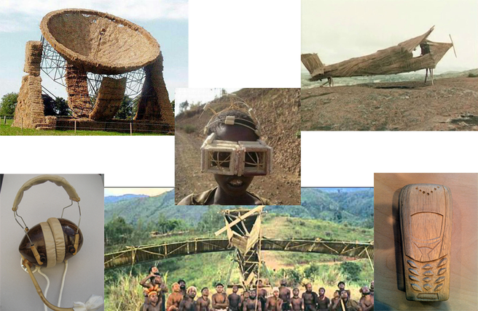
Cargo Cult Thinking: two things occur together → one causes the other
“The first principle is that you must not fool yourself—and you are the easiest person to fool.”
Notes:
Cargo cults: less technologically advanced civilization interacts with a more tech advance one
imitate what they do, hoping to get the same results
-> e.g. Southern pacific - they see these people show up and make air strips and radiotowers, and then planes with cargo show up.
So they begin building air strips and radiotowers assuming that it will lead to more delivery of cargo
“During the war they saw airplanes land with lots of good materials, and they want the same thing to happen now. So they’ve arranged to make things like runways, to put fires along the sides of the runways, to make a wooden hut for a man to sit in, with two wooden pieces on his head like headphones and bars of bamboo sticking out like antennas—he’s the controller—and they wait for the airplanes to land. They’re doing everything right. The form is perfect. It looks exactly the way it looked before. But it doesn’t work. No airplanes land.”

Slide 4
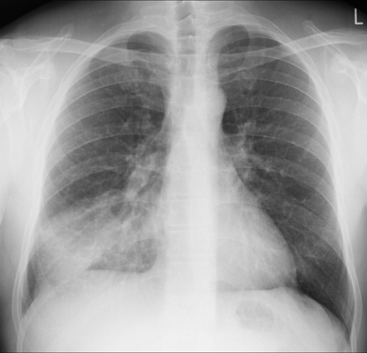
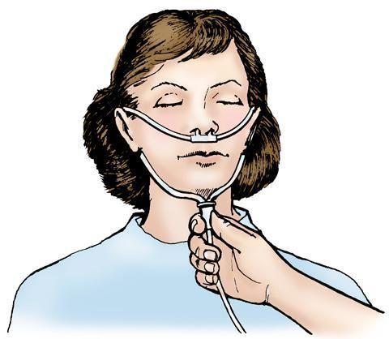
Hypoxemia and Dyspnea
Notes:
Problem: two things go together, we assume they cause each-other.
We don’t do things that would show us if we’re wrong.
Cargo cult thinking
Y’all learned this a disembodied factoids in MS2
We see people feeling dyspneic and having low oxygen - thus we assume it’s the low oxygen that is making them feel dyspneic.
This is Cargo cult thinking.
We’re going to briefly revisit the physiology you already have learned, but with an aim toward encapsulating it - Relearn it but integrate it with your current knowledge “encapsulation”
Walk through a few scenarios - my hope is that you can ask questions that extrapolate “if that’s true, then what about.. “
Ex hoc ergo propter hoc:
The SpO2 went down and my patient looks like shit, ergo, hypoxemia is making my patient feel like shit

Slide 5

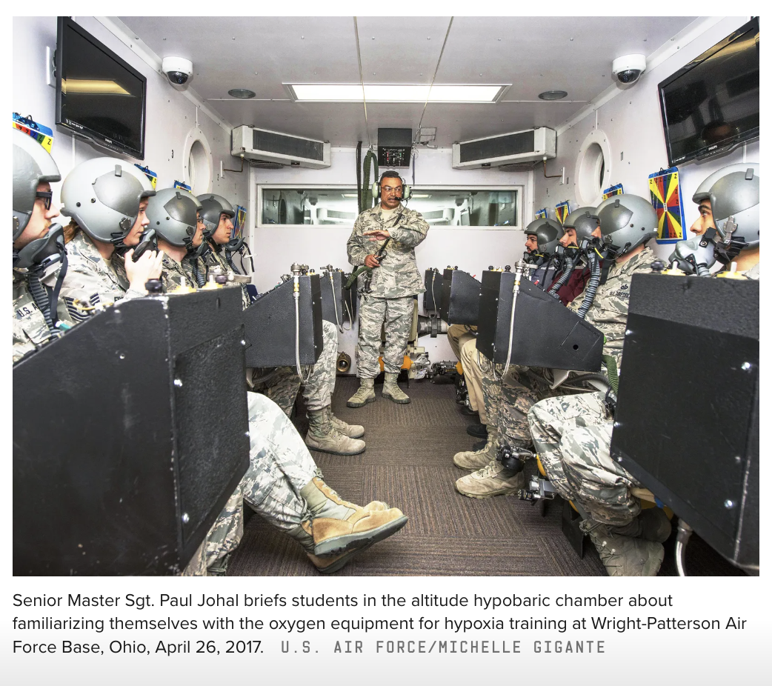
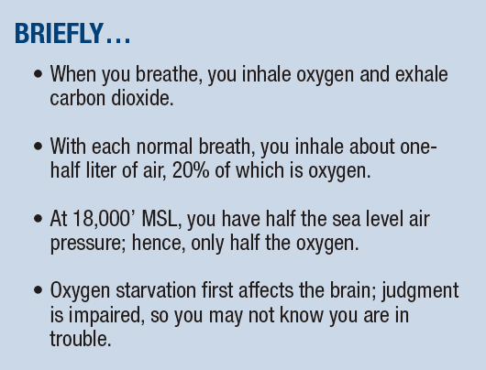
Solution to cargo cult thinking? Try to falsify
Still a problem, but not
respiratory distress

Slide 6
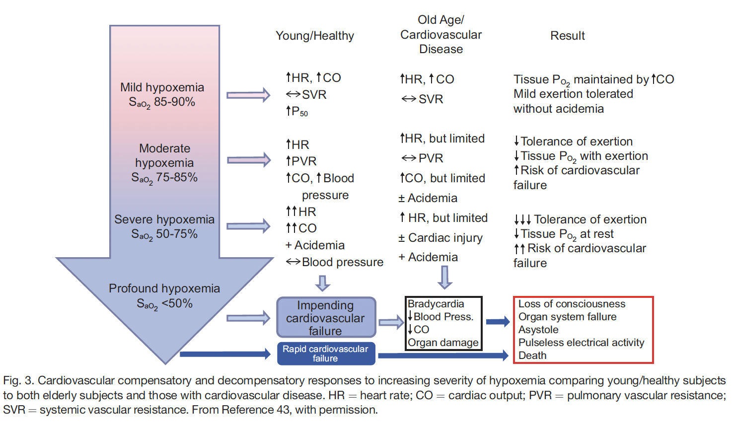
Hypoxemia… is a problem though
Notes:
Note: The consequences of hypoxemia are severe – so the takeaway is NOT to ignore it.

Slide 7
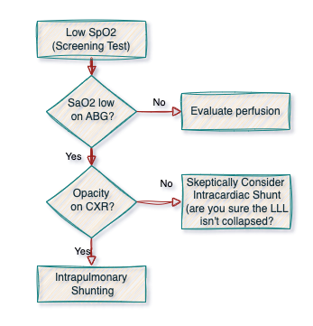
Refractory Hypoxemia Schema
RRT:
SpO2 is 75%,
15L NRB!
Notes:
The effect on hypoxemia is greater when there is more blood going through the area… hence, lower lobe collapse causes lots of shunting (due to gravity influencing where the blood goes).
Consolidations cause shunts

Slide 8
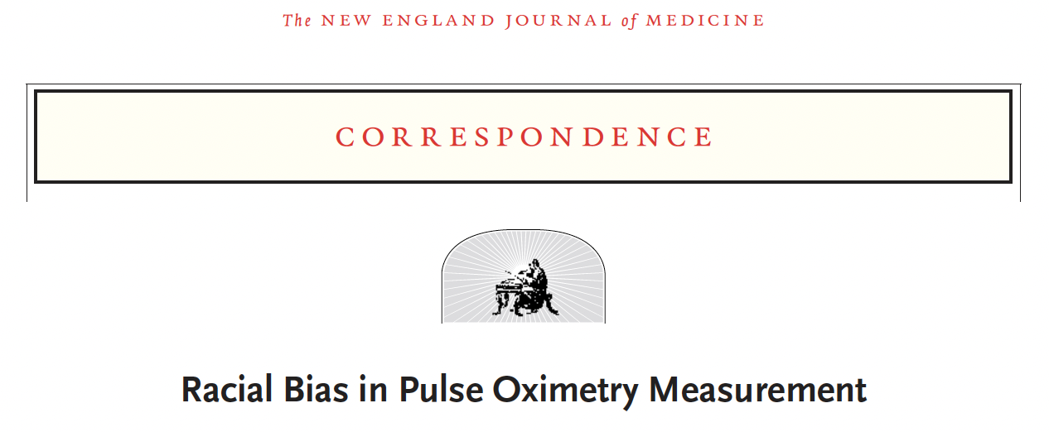
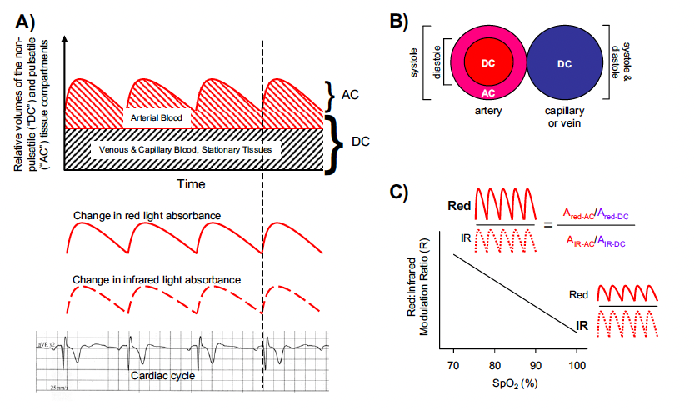
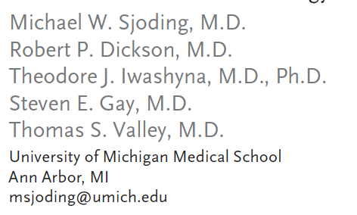
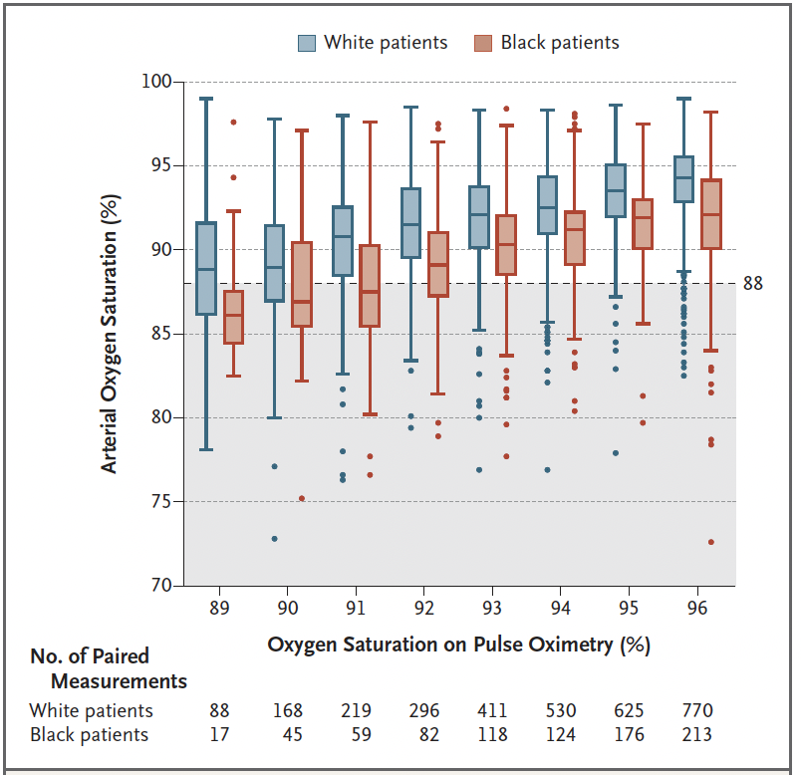
Pulse Oximetry: Screening Test
Pulse Required!
Lack of venous pulsation required!
Translucency required!
Baseline Accuracy: FDA standard 95% LOA within 2-3%*
Situations where accuracy worsens:
Hypoxemia below SaO2 80%
Poor perfusion: hypovolemia, heart failure, vasoconstriction, sepsis*
Carbon monoxide poisoning (*people who’ve smoked), sickle cell
Non-white skin, nail polish, make-up
This issue is not (yet) fixed!
Notes:
SpO2 is a surrogate
PaO2 represents the lungs’ functioning
SaO2 is the determinant of O2 delivery to the tissues
Pulse Oximeter Invented in ***1974*** by Takuo Aoyagi
A number of clinical conditions can affect pulse oximeter accuracy. For example, pulse oximeters may struggle to obtain readings in patients with poor fingertip perfusion, such as those with hypovolemia, heart failure, or vasoconstriction.^{2,6} Pulse oximeters also can provide false readings during carbon monoxide poisoning, severe anemia, or sepsis, and in patients wearing nail polish.²
It’s not super uncommon to admit a “refractory hypoxemia” RRT to the MICU and it ends up being cardiogenic shock (and they’re not hypoxemic)
Keep this separate from Dyspnea( in terms of differential and it terms of mgmt.)
We think SpO2 is pretty good… but how would you know? Think of a low SpO2 as a positive screen for hypoxemia.
Hypoxia – insufficient oxygen delivered to tissues to meet demands
Hypoxemia – low oxygen in the blood (most common cause of hypoxia)
P_{I}O2 – atmospheric oxygen (how much O2 is inspired)
P_{A}O2 – alveolar oxygen (how much O2 reaches the alveoli)
P_{a}O2 – oxygen dissolved in arterial blood (measured on ABG)
SaO2 – percent saturation of hemoglobin in arterial blood
CaO2 – oxygen content of art. blood (dissolved & Hb bound)
*ICUOnePager

Slide 9
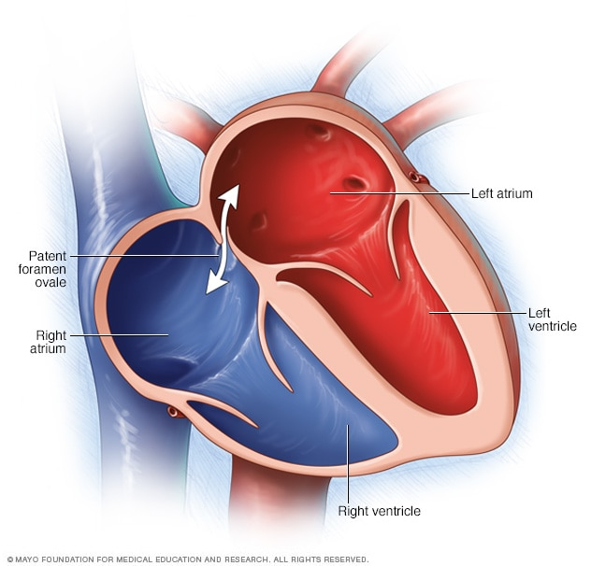
SaO2 is low?
Causes of hypoxemia that resolve with 6L O₂
V/Q Mismatch
Hypoventilation
Low FiO2, Low Barometric Pressure
Causes of hypoxemia that don’t resolve with 6L O₂
Shunt: Blood passes from venous to arterial circulation without contacting inhaled air.
Through the lung: opacity should be present on CXR
Through the heart…
In locations where congenital heart disease is identified and fixed, this generally requires systemic PA pressures
Notes:
Examples: HF (without lung disease) -> should not cause refractory hypoxemia without lung injiury

Slide 10
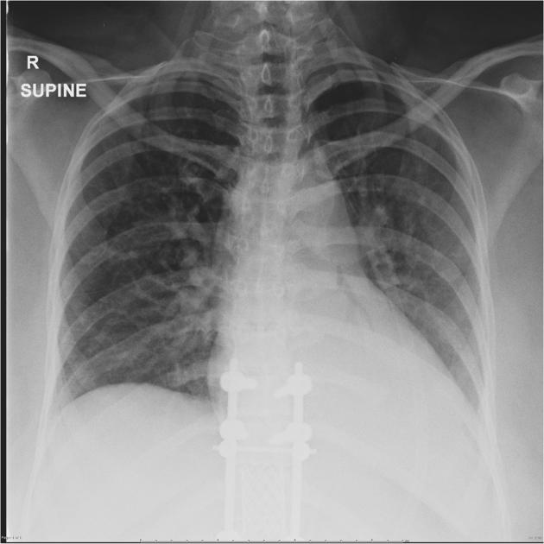
RRT 1! Hypoxemia
68M who is POD 2 after hip replacement.
No DVT prophylaxis.
Hypoxemia (~85%) develops on 6L Patient is hemodynamically stable
Mild tachypnea ~20 breaths per minute
You order a CXR and ABG
Differential?
Notes:
Mine personally:
LLL atelectasis >> Opiate hypoventilation = PE

Slide 11
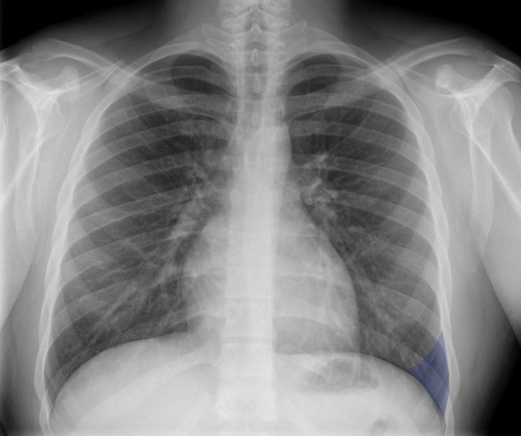
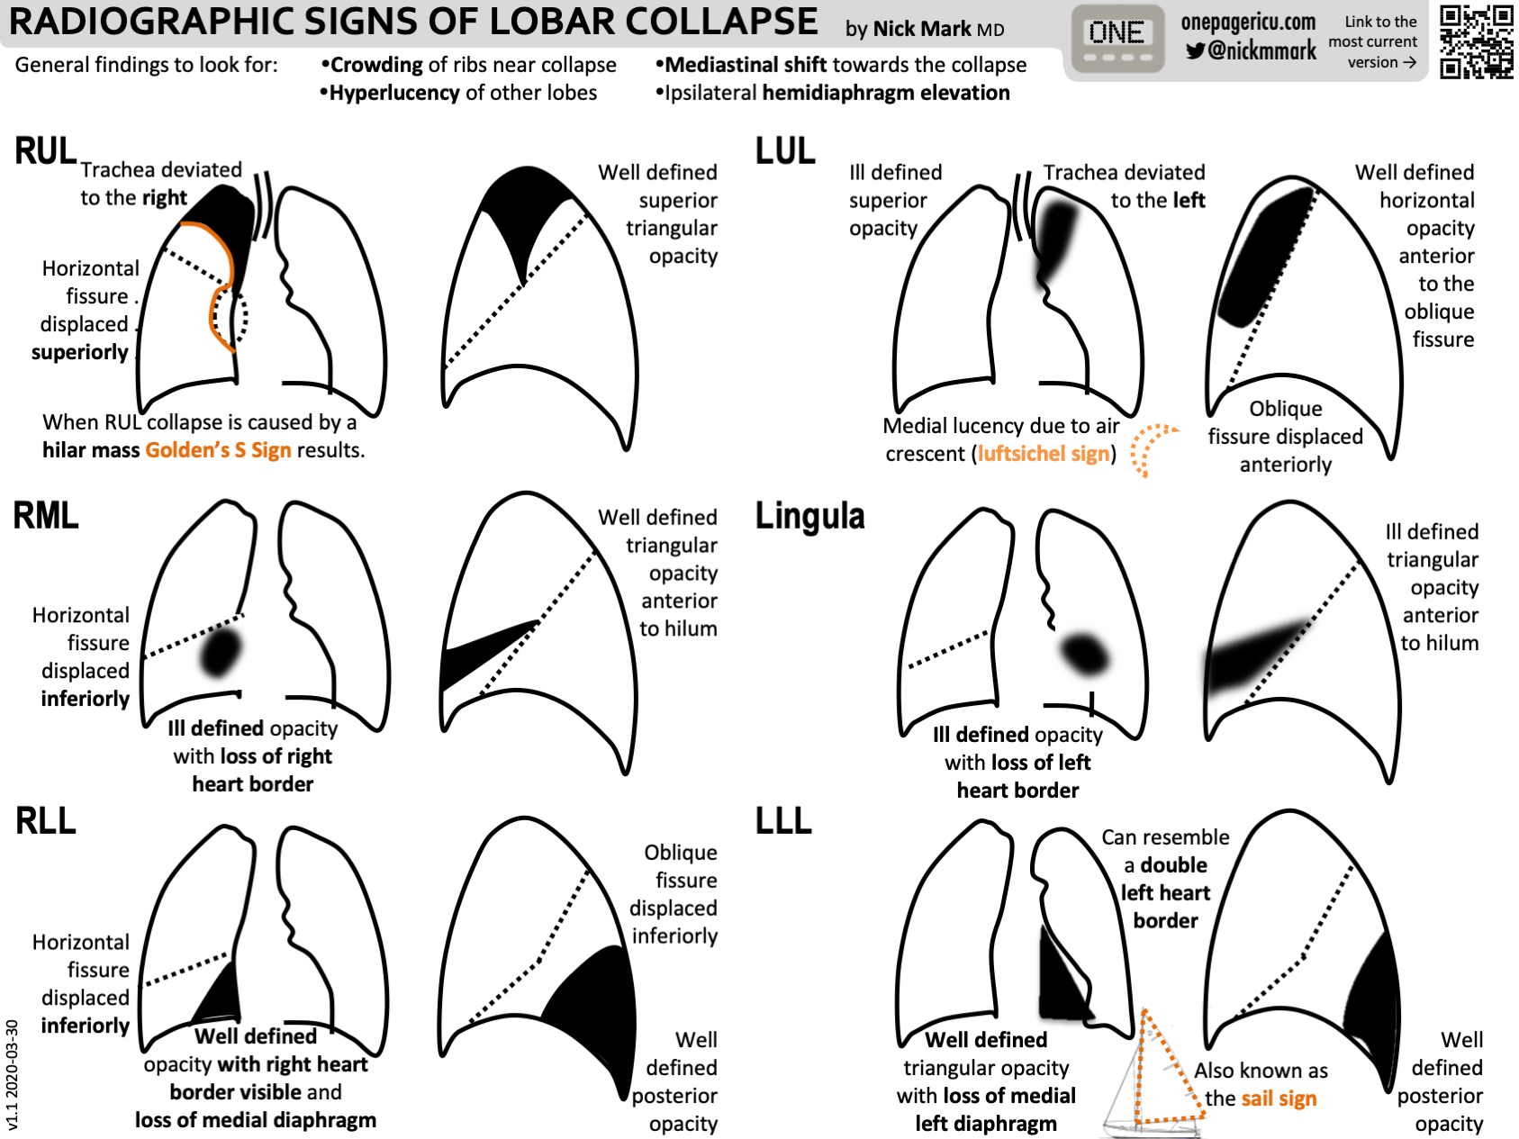
Refractory Hypoxemia Schema
Consolidations cause shunts!
Notes:
The effect on hypoxemia is greater when there is more blood going through the area… hence, lower lobe collapse causes lots of shunting (due to gravity influencing where the blood goes).
Consolidations cause shunts

Slide 12
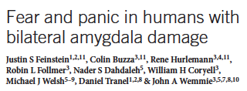

If hypoxemia doesn’t cause dyspnea… what does?
Urbach-Wiethe Disease: bilateral amygdala damage due to fat deposits.
Patient S.M.: No conditioning to aversive stimuli, no fear in life-threatening situations, no recognition of fear in others
35% Inhaled CO2 challenge (↑PaCO₂)
Air hunger provoked panic attack
First sensation of fear since childhood
Reproduced in others with U-W Disease
Notes:
Fear from brain-vent curve dissociation is NOT mediated by the medulla; it’s more primitive
Case report so interesting it’s published in Nature. NeuroSci!
FiCO2 35% and the case of S.M.
SM, amygdala fat deposits, carbon dioxide inhaled fear. Due to Urbach-Wiethe Dz
No fear to conventional stimuli, but high concentration of inhaled CO2 (35%) still provoked panic - ‘first time experienced fear since childhood’ https://www.nature.com/articles/nature.2013.12350
https://www.nature.com/articles/nn.3323
==> fear mechanism is independent of amygdala. (In this case fear comes through the chemo receptors, and not to the amygdala)
Justin Feinstein NIH grant Oklahoma inhaled carbon dioxide
https://grantome.com/grant/NIH/P20-GM121312-01-6548
RCT - https://clinicaltrials.gov/ct2/show/NCT03925987

Slide 13

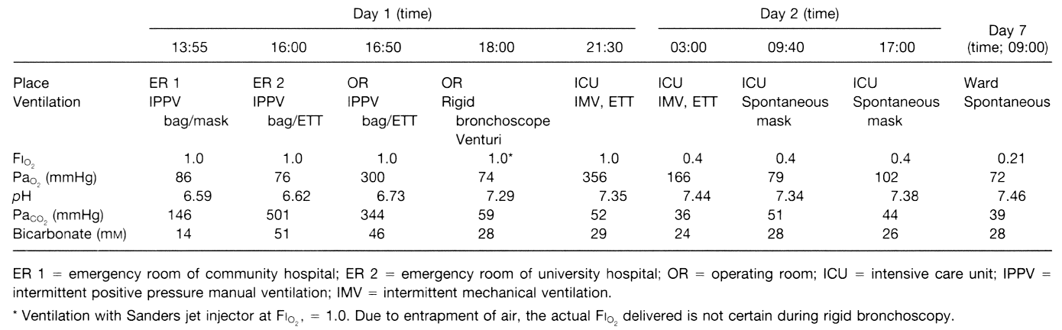
“16M fell into a ... transport wagon being filled with whole wheat grain and was immediately submersed…
…mouth and pharynx were cleared of large amounts of packed grain
Attempts to clear grain provoked instability
…placed in the Trendelenburg position for central line placement, it was noted that …several grain seeds would fall […from] the ETT during expiration.
During the subsequent 20 min, the surgeon performed manual chest percussions as the patient was moved alternately from supine to lateral and prone positions”
Patient had no residual neurologic or respiratory signs or symptoms…
Notes:
https://pubs.asahq.org/anesthesiology/article/87/4/993/36250/Management-of-Massive-Grain-Aspiration
A few mmHg of CO2 elevation provokes a fear in our lizard brain, yet an elevation of 500! Causes no lasting damage. Why?
Notable points from the article discussion:
“Although the proximal tracheobronchial tree became obstructed, the size of the grains (approximately 5 x 2 x 2 mm) would not permit them to pass into the respiratory bronchioles [3] because the small subsegmental bronchi of the fifth to eleventh generations have diameters from 1–3 mm. Interstitial spaces between the impacted grains allowed for diffusion and some clinically undetectable mass movement of gases.”
“The other lesson learned from this case is the seemingly benign nature of hypercapnia and acidosis if cardiovascular function is maintained and provided that the patient is not at risk for increased intracranial pressure.”

Slide 14
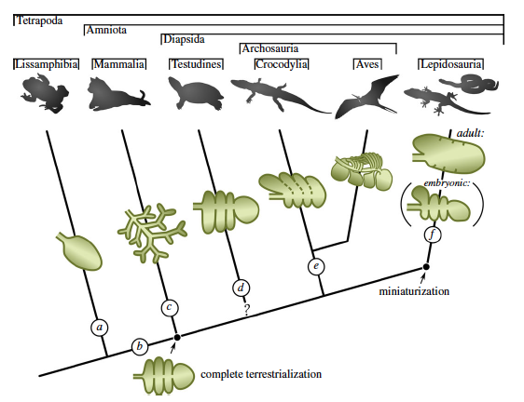
Evolution of the Control of Breathing
Gas Composition in Water | CO2 is 30x more soluble than O2 (low O2)
Gil Breathers | O2 is limiting factor, PaCO2 very low (1-4mmHg) → O2 determines respiratory drive in Fish/Amphibians
Gas Composition in Air | 21% O2, 0.04% CO2. [and both are equally ‘soluble’]
(Proto-) Lung Breathers | Ventilation only to ensure O2 → CO2 will be too* high → CO2 determines respiratory drive in mammals (etc.)
Notes:
Because CO2 is ~30 times more soluble in water compared to O2, water-breathers passively eliminate CO2 while satisfying their O2 demands through gill ventilation. Consequently, water-breathers typically have low PaCO2 values. In air, O2 is more abundant and a lower lung ventilation rate adequately supplies the tissues with O2 to support aerobic metabolism. However, the transition to air breathing would have resulted in the need to compensate a chronic respiratory acidosis due to hypoventilation of the lungs relative to CO2 production
How Important Is the CO2 Chemoreflex for the Control of Breathing? Environmental and Evolutionary Considerations
Joseph M. Santin
Why is our respiratory system set up this way? (to really need oxygen continuously, but to be tuned to carbon-dioxide)?
Consider water: almost no oxygen, CO2 content very similar to air.
Gil breathers: Need to move so much water past ‘lungs’ -> co2 removal is excessive: PaCO2 ~5,
When we moved to air - all of a sudden oxygen is easy to get *still have hemoglobin* -> ventilation and PaCO2 becomes the limiting step. (Ie. if we just breathed enough we’d get very high PaCO2 levels (which would displace O2 in the lung).
To finish off the teleologic argument:
- pH could remain compensated at any PaCO2 by retaining HCO3- (ie, any solution to the Henderson Hasselbach equation will work). However, hypercapnia will lead to a drop in alveolar O2 if higher than ~50 or so at room air. And we want a buffer. Back when there was more O2 in the air, it might have been optimal to have a higher PaCO2
Also, PaCO2 rises quicker with an increase in metabolic rate and has less ‘buffering’ in the blood – ie it changes more for a given amount of content changes. All helpful attributes for ventilatory control.

Slide 15
Keep O2 and CO2 Problems Separate!
O₂ | CO₂
Need sufficient O₂ gas tension ALWAYS | Won’t cause damage if varies (as long as O₂ available)
Body doesn’t keep as close tabs on it as you’d think | Brainstem is EXQUISITELY sensitive to it
We continually screen for low O₂ (pulse ox.) | We seldom monitor (except indirectly, by our observation of what the patient’s brainstem is doing)

Slide 16
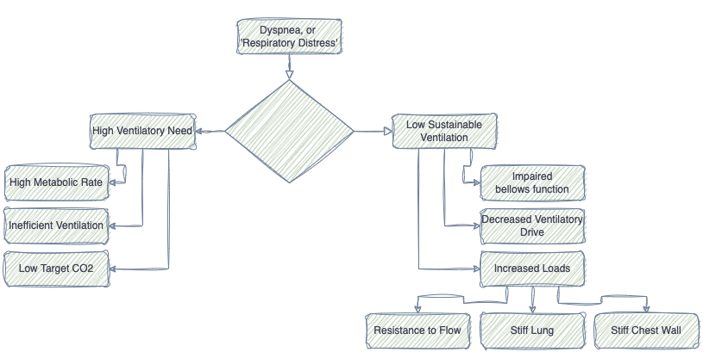

Schema for Ventilatory Failure

Slide 17

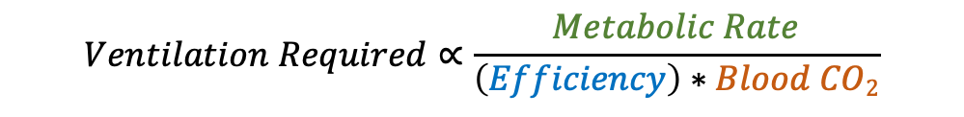
Need to exhale CO2: Supply vs Demand
You can understand this with equations, but they’re not required.
Fundamental Rules:
Molecules of CO2 produced = Molecules of CO2 exhaled to maintain homeostasis
Amount of CO2 you exhale is proportional to the amount of air that meets blood coming back to the heart from the tissues.
Amount of work is proportional to the amount of air you move past your nose & mouth (RR*Vt)
$$Ventilation Required∝\frac{Metabolic Rate}{\left(Efficiency\right)∗Blood CO2}$$
$$VE∝\frac{VCO2}{\left(1 −\frac{Vd}{Vt}\right)∗PaCO2}$$
Notes:
Things that increase needed ventilation:
Increased production of CO2 – example: exercise
You are wasting ventilation (air that moves passed your lips but doesn’t interact with de-oxygenated blood – example – PE
Your body is trying to lower the CO2 level to compensate for metabolic acidosis.
RR * Vt ∝ VCO₂ / [(1 - Vd/Vt) * PaCO₂]
What happens if you can’t breathe?
There are 3 contributors to
Your need for ventilation (passed the lips) is high because your ventilation is inefficient (high wasted ventilation = deadspace fraction)
Your need for ventilation (passed the lips) is high because your demand for gas-exchange (alveolar ventilation) is high (fast metabolism, low desired PaCO2 to compensate for acidosis)
Your need for ventilation is normal, but the work required to achieve that is high
Your need for ventilation is normal, but your ability to do that work is is impaired.

Slide 18
Need to exhale CO2: Supply vs Demand
Fundamental Rules:
Amount of CO2 you exhale is proportional to the amount of air that meets blood coming back to the heart from the tissues.
Amount of work is proportional to the amount of air you move past your nose & mouth (RR*Vt)
Molecules of CO2 produced = Molecules of CO2 exhaled to maintain homeostasis
3 things that influence how much air you need to breath:
1. Amount of CO2 production | 2. Ventilation Efficiency | 3. The concentration of CO2 in the blood
Metabolic Rate (VCO2) | Deadspace Fraction (Vd/Vt) | Respiratory Compensation
VE ∝ VCO2 ↑ Size Hyperthermia/Fever Work of breathing Exercise Carbohydrates (vs Lipids)
Notes:
You can understand this with equations, but they’re not required.
Things that increase needed ventilation:
Increased production of CO2 – example: exercise
You are wasting ventilation (air that moves passed your lips but doesn’t interact with de-oxygenated blood – example – PE
Your body is trying to lower the CO2 level to compensate for metabolic acidosis.
RR * Vt ∝ VCO₂ / [(1 - Vd/Vt) * PaCO₂]
What happens if you can’t breathe?
There are 3 contributors to
Your need for ventilation (passed the lips) is high because your ventilation is inefficient (high wasted ventilation = deadspace fraction)
Your need for ventilation (passed the lips) is high because your demand for gas-exchange (alveolar ventilation) is high (fast metabolism, low desired PaCO2 to compensate for acidosis)
Your need for ventilation is normal, but the work required to achieve that is high
Your need for ventilation is normal, but your ability to do that work is is impaired.

Slide 19
Need to exhale CO2: Supply vs Demand
Fundamental Rules:
Amount of CO2 you exhale is proportional to the amount of air that meets blood coming back to the heart from the tissues.
Amount of work is proportional to the amount of air you move past your nose & mouth (RR*Vt)
Molecules of CO2 produced = Molecules of CO2 exhaled to maintain homeostasis
3 things that influence how much air you need to breath:
1. Amount of CO2 production | 2. Ventilation Efficiency | 3. The concentration of CO2 in the blood
Metabolic Rate (VCO2) | Deadspace Fraction (Vd/Vt) | Respiratory Compensation
VE ∝ VCO2 ↑ Size Hyperthermia/Fever Work of breathing Exercise Carbohydrates (vs Lipids) | VE ∝ 1/(1-Vd/Vt) Vd = Amount of wasted VE Vd/Vt = Proportion wasted 1-Vd/Vt = Proportion not wasted [more efficient]
Notes:
Things that increase needed ventilation:
Increased production of CO2 – example: exercise
You are wasting ventilation (air that moves passed your lips but doesn’t interact with de-oxygenated blood – example – PE
Your body is trying to lower the CO2 level to compensate for metabolic acidosis.
RR * Vt ∝ VCO₂ / [(1 - Vd/Vt) * PaCO₂]
What happens if you can’t breathe?
There are 3 contributors to
Your need for ventilation (passed the lips) is high because your ventilation is inefficient (high wasted ventilation = deadspace fraction)
Your need for ventilation (passed the lips) is high because your demand for gas-exchange (alveolar ventilation) is high (fast metabolism, low desired PaCO2 to compensate for acidosis)
Your need for ventilation is normal, but the work required to achieve that is high
Your need for ventilation is normal, but your ability to do that work is is impaired.

Slide 20
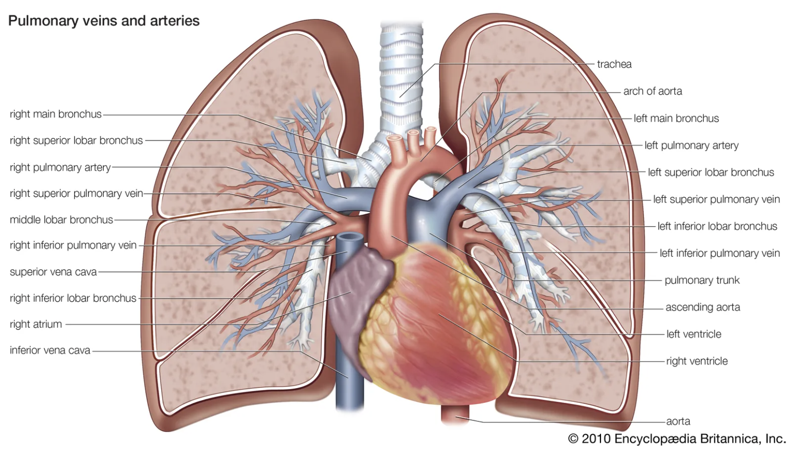
Ventilation (past mouth)
L Main PA Occlusive Thrombus
Blood no longer goes to L lung
Inhaled air does
Therefore, 2x the ventilation (mouth) required for same gas-exchange
Vd/Vt =~ ½
Ventilation participating in gas-exchange (Alveolar Ventilation)
= ½ of the mouth ventilation
Wasted ventilation (no blood flow to this side)
= ½ of the mouth ventilation

Slide 21
Need to exhale CO2: Supply vs Demand
Fundamental Rules:
Amount of CO2 you exhale is proportional to the amount of air that meets blood coming back to the heart from the tissues.
Amount of work is proportional to the amount of air you move past your nose & mouth (RR*Vt)
Molecules of CO2 produced = Molecules of CO2 exhaled to maintain homeostasis
3 things that influence how much air you need to breath:
1. Amount of CO2 production | 2. Ventilation Efficiency | 3. The concentration of CO2 in the blood
Metabolic Rate (VCO2) | Deadspace Fraction (Vd/Vt) | Respiratory Compensation
VE ∝ VCO2 ↑ Size Hyperthermia/Fever Work of breathing Exercise Carbohydrates (vs Lipids) | VE ∝ 1/(1-Vd/Vt) Vd = Amount of wasted VE Vd/Vt = Proportion wasted 1-Vd/Vt = Proportion not wasted [more efficient] | VE ∝ 1/PaCO2 Exhaled [CO2] ∝ blood [CO2] Why might the body want low PaCO2? Why might having a high PaCO2 help?
Notes:
Things that increase needed ventilation:
Increased production of CO2 – example: exercise
You are wasting ventilation (air that moves passed your lips but doesn’t interact with de-oxygenated blood – example – PE
Your body is trying to lower the CO2 level to compensate for metabolic acidosis.
What happens if you can’t breathe?
There are 3 contributors to
Your need for ventilation (passed the lips) is high because your ventilation is inefficient (high wasted ventilation = deadspace fraction)
Your need for ventilation (passed the lips) is high because your demand for gas-exchange (alveolar ventilation) is high (fast metabolism, low desired PaCO2 to compensate for acidosis)
Your need for ventilation is normal, but the work required to achieve that is high
Your need for ventilation is normal, but your ability to do that work is is impaired.

Slide 22

3 scenarios: why are they breathing hard?
A patient in DKA (Kussmaul Breathing)?
$$VE∝\frac{VCO2}{\left(1 −\frac{Vd}{Vt}\right)∗PaCO2}$$
3 things that influence how much air you need to breath:
1. Amount of CO2 production | 2. Ventilation Efficiency | 3. The concentration of CO2 in the blood
Metabolic Rate (VCO2) | Deadspace Fraction (Vd/Vt) | Respiratory Compensation
VE ∝ VCO2 ↑ Size Hyperthermia/Fever Work of breathing Exercise Carbohydrates (vs Lipids) | VE ∝ 1/(1-Vd/Vt) Vd = Amount of wasted VE Vd/Vt = Proportion wasted 1-Vd/Vt = Proportion not wasted [more efficient] | VE ∝ 1/PaCO2 Exhaled [CO2] ∝ blood [CO2]

Slide 23
3 scenarios: why are they breathing hard?
A runner, before they hit their anaerobic threshold?
A runner, after they hit their anaerobic threshold?
$$VE∝\frac{VCO2}{\left(1 −\frac{Vd}{Vt}\right)∗PaCO2}$$
3 things that influence how much air you need to breath:
1. Amount of CO2 production | 2. Ventilation Efficiency | 3. The concentration of CO2 in the blood
Metabolic Rate (VCO2) | Deadspace Fraction (Vd/Vt) | Respiratory Compensation
VE ∝ VCO2 ↑ Size Hyperthermia/Fever Work of breathing Exercise Carbohydrates (vs Lipids) | VE ∝ 1/(1-Vd/Vt) Vd = Amount of wasted VE Vd/Vt = Proportion wasted 1-Vd/Vt = Proportion not wasted [more efficient] | VE ∝ 1/PaCO2 Exhaled [CO2] ∝ blood [CO2]

Slide 24
3 scenarios: why are they breathing hard?
A patient with severe pulmonary arterial hypertension?
$$VE∝\frac{VCO2}{\left(1 −\frac{Vd}{Vt}\right)∗PaCO2}$$
3 things that influence how much air you need to breath:
1. Amount of CO2 production | 2. Ventilation Efficiency | 3. The concentration of CO2 in the blood
Metabolic Rate (VCO2) | Deadspace Fraction (Vd/Vt) | Respiratory Compensation
VE ∝ VCO2 ↑ Size Hyperthermia/Fever Work of breathing Exercise Carbohydrates (vs Lipids) | VE ∝ 1/(1-Vd/Vt) Vd = Amount of wasted VE Vd/Vt = Proportion wasted 1-Vd/Vt = Proportion not wasted [more efficient] | VE ∝ 1/PaCO2 Exhaled [CO2] ∝ blood [CO2]

Slide 25

Need to exhale CO2: Supply vs Demand
How much air movement can you sustain?
Causes of inability to sustain the needed minute ventilation
Impaired bellows function (Muscle weakness/inefficiency) | Increased respiratory system loads | Decreased ventilatory drive*
Neuromuscular disease Hyperinflation Respiratory muscle hypoxia Pleural Disease

Slide 26
Need to exhale CO2: Supply vs Demand
How much air movement can you sustain?
Causes of inability to sustain the needed minute ventilation
Muscle weakness/inefficiency | Increased respiratory system loads | Decreased ventilatory drive*
Neuromuscular disease Hyperinflation Respiratory muscle hypoxia Pleural Disease | Elevated airway resistance Stiff Lungs Low chest wall compliance

Slide 27
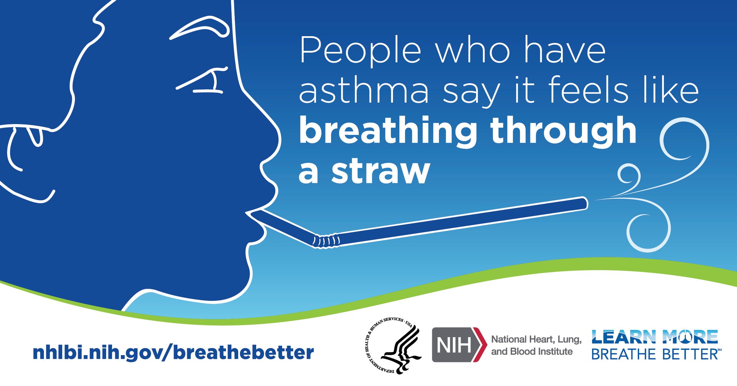
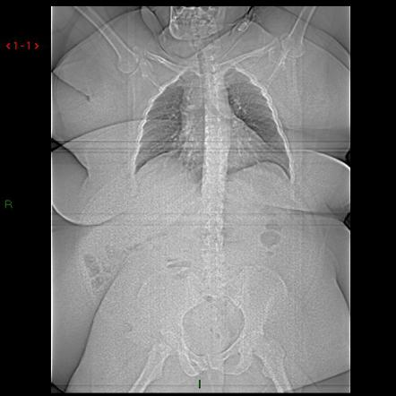
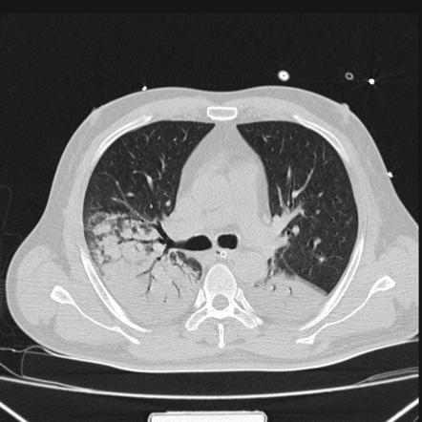
Notes:
Resistive loads: takes more work to move the air through airways
Elastic loads: lungs are stiff, so it takes more energy to inflate them
Inertial loads: it takes more energy to move all the mass on the outside of the chest.

Slide 28
Need to exhale CO2: Supply vs Demand
How much air movement can you sustain?
*A talk for another day
Causes of inability to sustain the needed minute ventilation
Muscle weakness/inefficiency | Increased respiratory system loads | Decreased ventilatory drive*
Neuromuscular disease Hyperinflation Respiratory muscle hypoxia Pleural Disease | Elevated airway resistance Stiff Lungs Low chest wall compliance | Opiates and other sedatives Chronic compensated hypercapnia Sleep Metabolic alkalosis

Slide 29

Schema for Ventilatory Failure
We monitor O2
We infer things about CO2
Patient’s brainstem monitors it for us
When do you need an ABG?
$$VE∝\frac{VCO2}{\left(1 −\frac{Vd}{Vt}\right)∗PaCO2}$$

Slide 30
Schema for Ventilatory Failure
$$VE∝\frac{VCO2}{\left(1 −\frac{Vd}{Vt}\right)∗PaCO2}$$

Slide 31
Schema for Ventilatory Failure
$$VE∝\frac{VCO2}{\left(1 −\frac{Vd}{Vt}\right)∗PaCO2}$$
*Severity of illness dependent

Slide 32
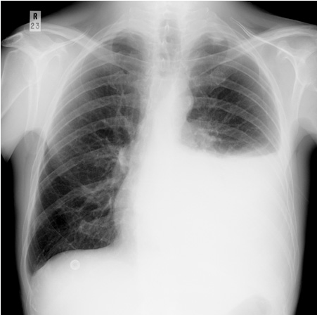
Schema for Ventilatory Failure
$$VE∝\frac{VCO2}{\left(1 −\frac{Vd}{Vt}\right)∗PaCO2}$$

Slide 33
Schema for Ventilatory Failure
$$VE∝\frac{VCO2}{\left(1 −\frac{Vd}{Vt}\right)∗PaCO2}$$

Slide 34
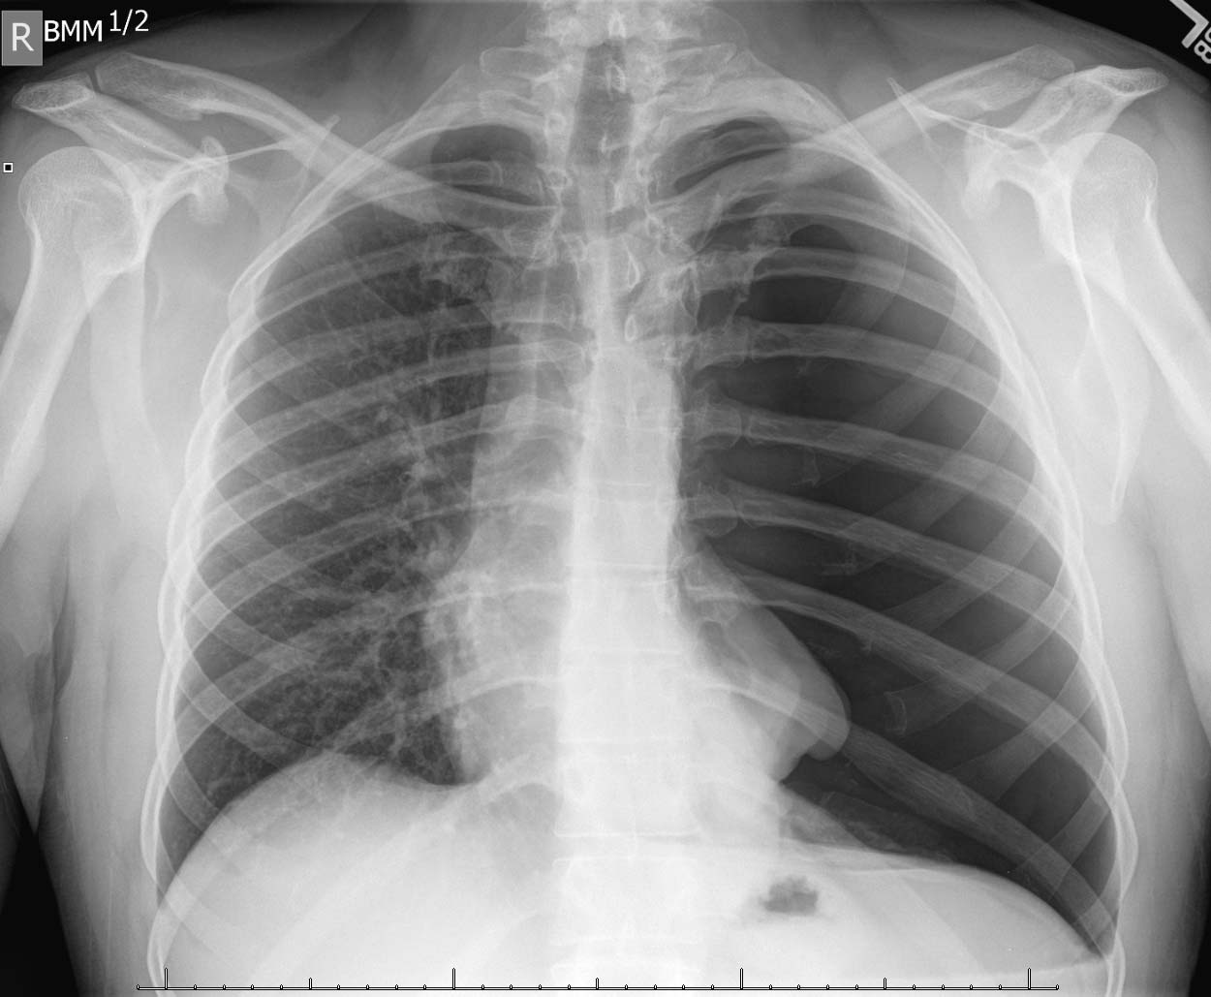
Schema for Ventilatory Failure
$$VE∝\frac{VCO2}{\left(1 −\frac{Vd}{Vt}\right)∗PaCO2}$$

Slide 35
Schema for Ventilatory Failure
$$VE∝\frac{VCO2}{\left(1 −\frac{Vd}{Vt}\right)∗PaCO2}$$
*Pain and pleural irritation causing hyperventilation

Slide 36
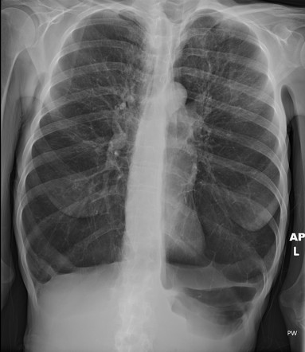
Schema for Ventilatory Failure
$$VE∝\frac{VCO2}{\left(1 −\frac{Vd}{Vt}\right)∗PaCO2}$$

Slide 37
Schema for Ventilatory Failure
$$VE∝\frac{VCO2}{\left(1 −\frac{Vd}{Vt}\right)∗PaCO2}$$

Slide 38
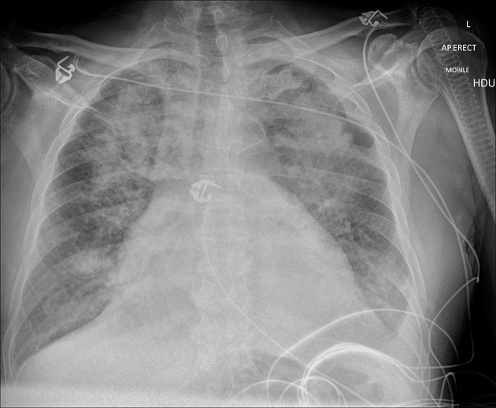
Schema for Ventilatory Failure
$$VE∝\frac{VCO2}{\left(1 −\frac{Vd}{Vt}\right)∗PaCO2}$$

Slide 39
Schema for Ventilatory Failure
$$VE∝\frac{VCO2}{\left(1 −\frac{Vd}{Vt}\right)∗PaCO2}$$

Slide 40
Summary:
Keep O₂ and CO₂ problems separate in your thinking
Low O₂ is not the main cause of dyspnea
If it’s real and it doesn’t get better with 6L, it’s shunting.
Symptoms are driven by CO₂ flux
Symptoms occur when it’s hard to sustain what you need
Do they need a lot?
High metabolic rate, Inefficient Ventilation, Low blood CO2
Can they not sustain much?
Bellows don’t work, Breathing control doesn’t work*, Loads on system
Notes:
Hypoxemia and Dyspnea often go together – but hypoxemia isn’t the main cause of dyspnea.
CO2: out of sight (we don’t frequently monitor it directly) therefore out of mind (we don’t think of it)
But we should – it’s what the brainstem is monitoring.

Slide 41
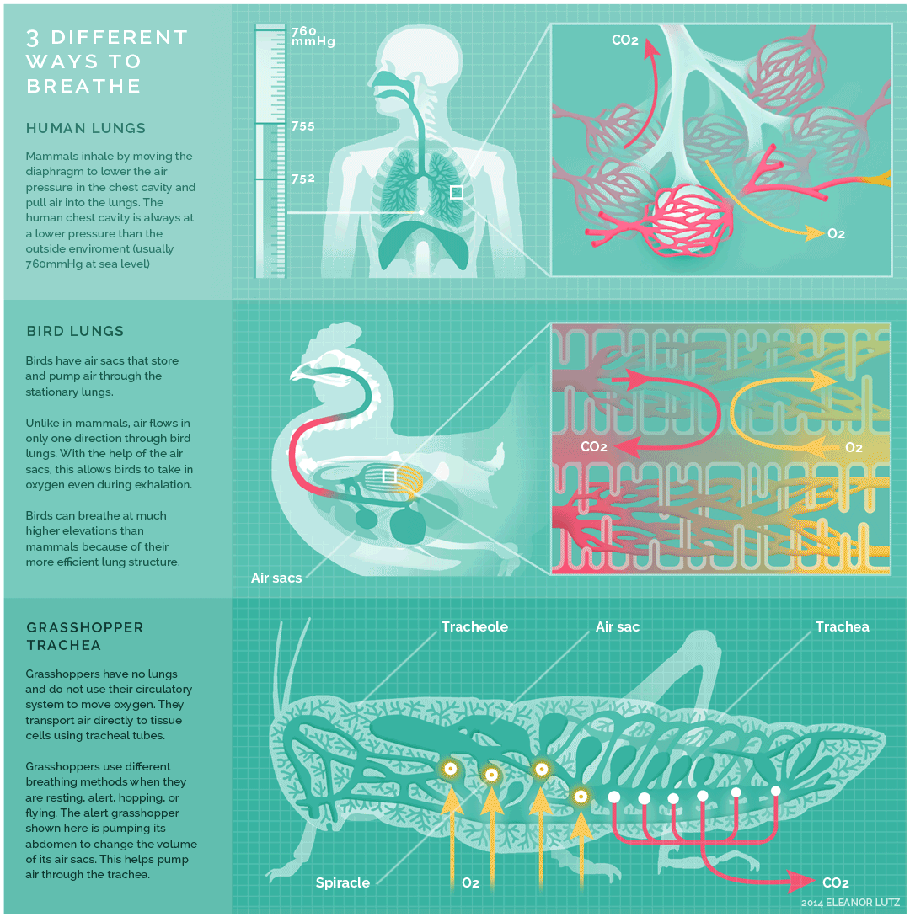
Notes:
http://tabletopwhale.com/2014/10/24/3-different-ways-to-breathe.html

